Slide 1


APHELION PROPERTY INVESTMENTS (API)
REO
Sam Johnson - Founder
Shay Schreurs - CoFounder
Johnathan Overton - Existential Entity

Slide 2


01
Business overview

Slide 3


Mission statement
With rising populations, Aphelion realizes that Real Estate is becoming an increasingly competitive industry. Our goal is to leverage existing financial technologies in order to outpace our competitors in locating and acquiring the greatest Real Estate Investments for our clients.

Slide 4


Motivations
Can Pandas be leveraged, using an API, to provide up-to-date Real Estate data for a designated area?
Can that data be restructured to offer insights into the best probabilistic Real Estate Opportunities?
Having identified a property(s) can an API provide comparable properties so as to readily identify price advantages?

Slide 5


—Ryan Serhant
“You will be amazed at how you can predict the future with your confidence.”

Slide 6


Method
Install Realty Mole API
Target an opportunity area
Pull and restructure data from opportunity area
Compare comparable properties
Create visualizations for simplification in storytelling

Slide 7


02
Market analysis

Slide 8
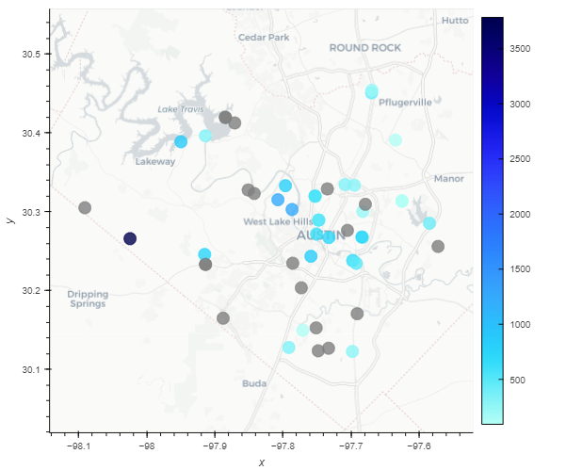
Austin, TX Raw Listings

Slide 9
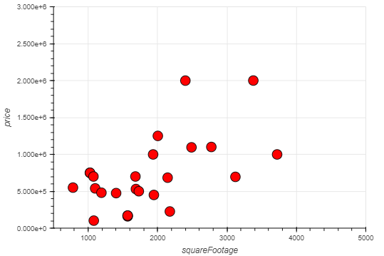
Raw Listings Price/PPSF Comparison

Slide 10
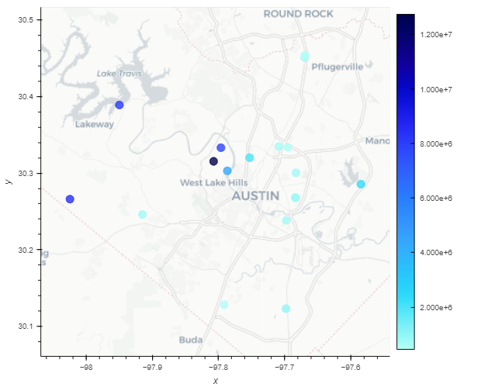
Location by Price

Slide 11
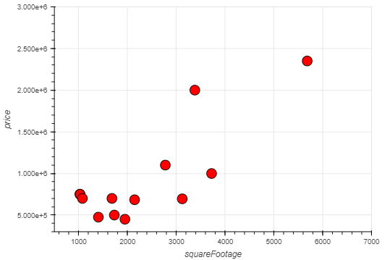
Austin, TX Single Family Homes

Slide 12
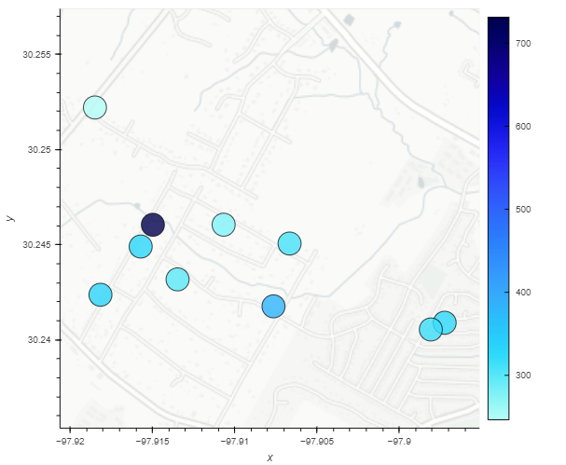
Single Family Homes: Price Per SF

Slide 13
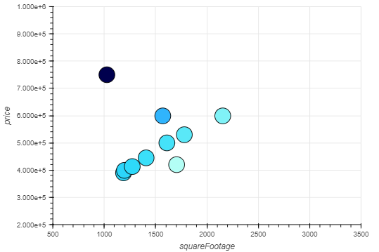
Single Family Homes: Comparables
Eureka!
Light colored points in dark densities!!

Slide 14


03
Management plan
The Aphelion Real Estate
Team

Slide 15
Organizational chart
CEO
Sam Johnson
Johnathan
Overton
Shay Schreurs

Slide 16


Thank you!
johnathan.overton83@gmail.com
yourwebsite.com
CREDITS: This presentation template was created by Slidesgo, and includes icons by Flaticon and infographics & images by Freepik

